Slide 1


The HydroServer Collaborative Website
CUAHSI
HIS
Sharing hydrologic data
http://his.cuahsi.org/
Jeffery S. Horsburgh
David G. Tarboton, Kimberly A. T. Schreuders, David R. Maidment, Ilya Zaslavsky, and David Valentine
And the Rest of the CUAHSI HIS Team
Support
EAR 0622374

Slide 2
http://hydroserver.codeplex.com Summary of Features
Project description – what is HydroServer
Downloads – get the software
Documentation – what to do once you have the software
Discussions – getting help with specific questions
Issue Tracker – reporting issues or feature requests
Source Code – download the source code and contribute

Slide 3
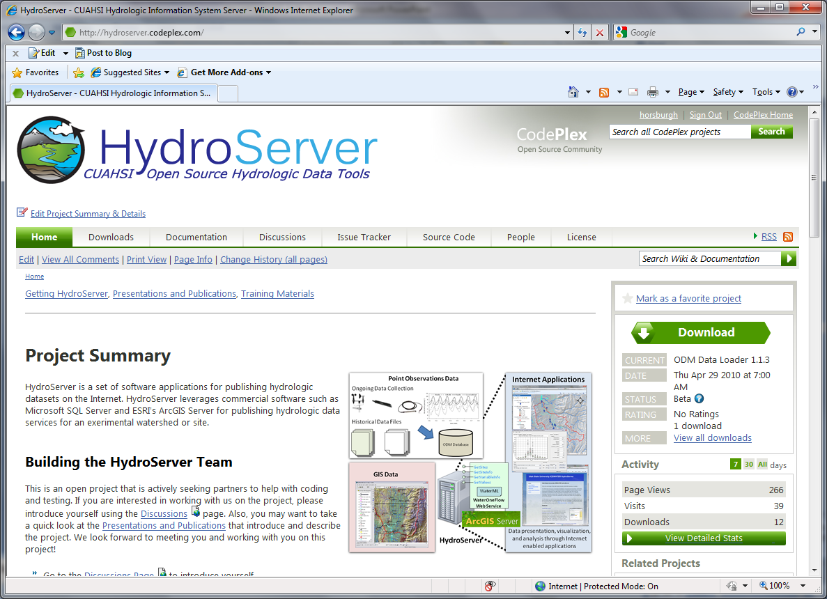

Slide 4
Questions?
CUAHSI
HIS
Sharing hydrologic data
http://his.cuahsi.org/
Support
EAR 0622374

